Slide 1
DNA Nanotech. DNA/RNA Computing

Slide 2
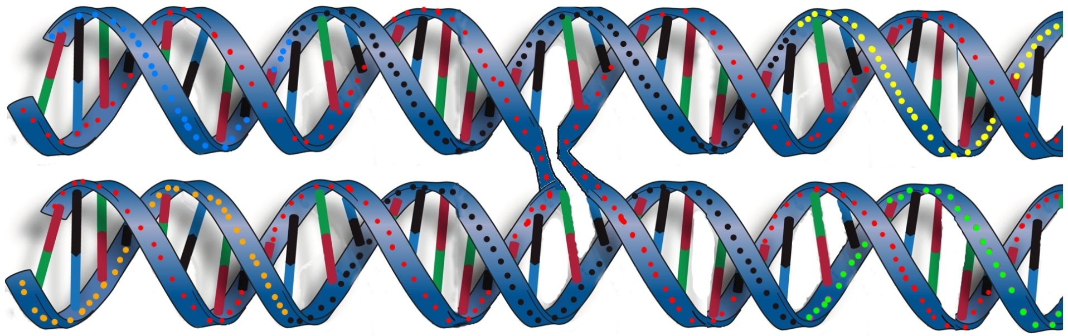
DNA Nanotech. DNA/RNA Computing
Goal: building nano-scale shapes using DNA
Basic Principal: Double-crossover units
5’ ………TGTATATGTGTGGGAACAGGTTTAAT………3’
CCACACATATACA-3’
‘5-ATTAAACCTGTTC
5’-TTCTCAATATACT
GAGGACTTTACCT-3’
3’-….........AAGAGTTATATGACTCCTGAAATGGA…....5’
Crossover point

Slide 3
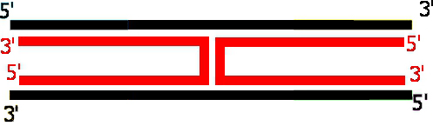
DNA Nanotech. DNA/RNA Computing
Goal: building nano-scale shapes using DNA
Basic Principal: Double-crossover units
=

Slide 4
DNA Nanotech. DNA/RNA Computing
Goal: building nano-scale shapes using DNA
Basic Principal: Double-crossover units
^ ^ ^
. . .
. . .
.
.
.
.
.
.
. . .
. . .
. . .

Slide 5
DNA Nanotech. DNA/RNA Computing
Constraint: odd (even) half-turns between successive (every other) crossovers
1 half-turn = 5.3 bases = 1.8 nanometer
odd
even

Slide 6
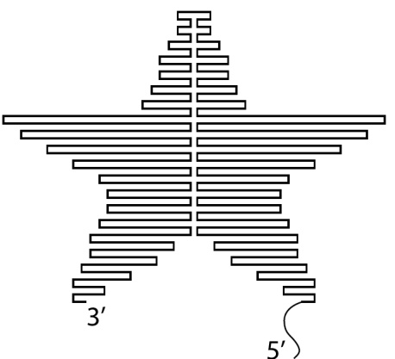
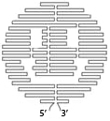

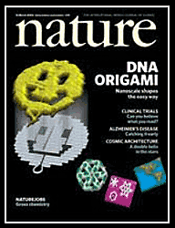
DNA Nanotech. DNA/RNA Computing
Method: DNA Origami (state-of-the-art)
5’
Rothemund, 2006
3’

Slide 7



DNA Nanotech. DNA/RNA Computing
Method: DNA Origami
The Good: Programmability, any desired shape, 6nm pixel size
The Bad: Design, must use optimization software every time (a computationally-hard task)
The Ugly: Cost, synthesis of new stapler strands for each shape (>200 strands for a 100x100 nm shape, ~1500$)

Slide 8
DNA Nanotech. DNA/RNA Computing
An Alternative:

Slide 9
DNA Nanotech. DNA/RNA Computing
An Alternative:
Ligase

Slide 10
DNA Nanotech. DNA/RNA Computing
An Alternative:
5’
3’

Slide 11
DNA Nanotech. DNA/RNA Computing
An Alternative:
Library Scaffold:
Vertical Strands

Slide 12
DNA Nanotech. DNA/RNA Computing
An Alternative:
Library Scaffold:
Vertical Strands
Horizental Strands

Slide 13
DNA Nanotech. DNA/RNA Computing
An Alternative:
No more Design or Synthesis after this point
Now: Programming

Slide 14
DNA Computation of Solutions to Edge-Matching Puzzles
Example: Six degrees of Separation
So you are a friend of X₁ who is a friend of X₂ … who is a friend of X₆ who is a friend of Nelson Mandela.
1. Synthesis
2. Hybridization
3. Ligation
Replicate sequences that begin with “You” and end with “Nelson Mandela”
4. Replication:
Post-Ligation Product

Slide 15
DNA Computation of Solutions to Edge-Matching Puzzles
Example: Six degrees of Separation
So you are a friend of X₁ who is a friend of X₂ … who is a friend of X₆ who is a friend of Nelson Mandela.
Post-Replication product:
dsDNA sequences of different lengths, all begin with you and end with Mandela
1. Synthesis
2. Hybridization
3. Ligation
4. Replication

Slide 16
DNA Computation of Solutions to Edge-Matching Puzzles
Example: Six degrees of Separation
So you are a friend of X₁ who is a friend of X₂ … who is a friend of X₆ who is a friend of Nelson Mandela.
Post-Replication product:
dsDNA sequences of different lengths, all begin with you and end with Mandela
1. Synthesis
2. Hybridization
3. Ligation
4. Replication

Slide 17
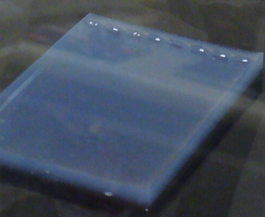
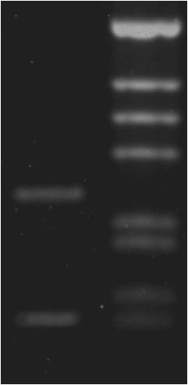
DNA Computation of Solutions to Edge-Matching Puzzles
Example: Six degrees of Separation
So you are a friend of X₁ who is a friend of X₂ … who is a friend of X₆ who is a friend of Nelson Mandela.
-
1. Synthesis
2. Hybridization
3. Ligation
4. Replication
5. Gel Electrophoresis
Your best chance of meeting Mandela
+
Reference ladder

Slide 18
DNA Computation of Solutions to Edge-Matching Puzzles
Challenge: pack a collection of square tiles on a square board such that:
All abutting edges match in color
All boundary edges are grey

Slide 19
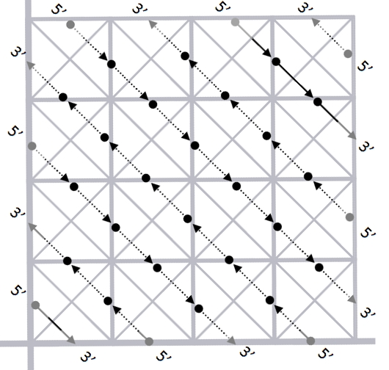
DNA Computation of Solutions to Edge-Matching Puzzles
1. Define the problem
2. Formulate an algorithm
3. Implement a DNA lab protocol
Ultimately we seek to find the set of DNA lanes that encode the full solution to the Puzzle:
DNA Grid
Phase I: Enumerate DNA lanes (“stapling”)
Phase II: Build DNA grid by stacking lanes (“bridging”)

Slide 20
DNA Computation of Solutions to Edge-Matching Puzzles
1. Define the problem
2. Formulate an algorithm
3. Implement a DNA lab protocol
Step 5: Bridge lanes.
Bridging strands
5’………..XXXXXTGTATATGTGTGGGAACAGGTTTAATXXXXX………3’
CCACACATATACA-3’
‘5-ATTAAACCTGTTC
5’-TTCTCAATATACT
GAGGACTTTACCT-3’
3’-.........XXXXXXAAGAGTTATATGA CTCCTGAAATGGAXXXXX…..5’

Slide 21
5’………..XXXXXTGTATATGTGTGGGAACAGGTTTAATXXXXX………3’
CCACACATATACA-3’
‘5-ATTAAACCTGTTC
5’-TTCTCAATATACT
GAGGACTTTACCT-3’
3’-.........XXXXXXAAGAGTTATATGA CTCCTGAAATGGAXXXXX…..5’

Slide 22
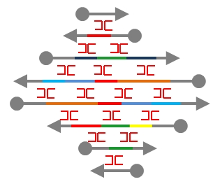
DNA Computation of Solutions to Edge-Matching Puzzles
1. Define the problem
2. Formulate an algorithm
3. Implement a DNA lab protocol
Puzzle Solution
=

Slide 23
DNA Computation of Solutions to Edge-Matching Puzzles
Thank you

